Slide 1

Project Tracker May 2017
By: Nasim

Slide 2
Learning application
Weekly Status – May 22, 2017
Overall
Build
Executive Summary
Upcoming Activities
Prototype of Application architecture and DevOps practices for build , packaging and deployment pipelines for Dev, QA, UAT, PRD environment. Modules included are Database Project, Login, Dictionaries, Self Assessment test for foreign language learning.
Self assessment test for users and Dictionary creation.
Unit test coverage for Website and Database both.
Build , Release and Deployment pipelines for DEV, QA, UAT, PROD.
Functional Regression test suites (Coded UI)
Feedback and Support system(JIRA/BMC)
Milestones / Key Dates
Planned Date
Actual / Forecast Date
Deliverables
Third week May’17
Deliverables | Define | Build | Release | Rollout
Application architecture | 19/05/17 | 19/05/17 | 19/05/17 | 100%
Database Project with unit tests coverage | 20/05/17 | 20/05/17 | 20/05/17 | 50%
Application design with unit tests coverage | 20/05/17 | 21/05/17 | 21/05/17 | 20%
CI Build | 22/05/17 | 22/05/17 | 22/05/17 | 30%
Jan 25
W3
Login Page creation | 19/05 | 19/05
Home page creation | 19/05 | 19/05
Database creation (Code first approach) | 20/05 | 20/05
Jan 25
Jan 25
Fourth week May’17
W4
Assessment forms creation | 23/05
Unit test coverage | 23/05
Build and Release pipelines | 24/05
Risks
Risk | Get-To-Green Plan (GtG) | Owner | Due Date
Deployment environment is missing. | Needs deployment environment to check CI, CD pipelines | PritiX | 22/05/2017
First week Jun’17
W1
Regression Test | 06/06
Service desk | TBD
Bug fixing and support | TBD
Highlights
Fourth Quarter 2017
Database project for automatic deployment of database related changes. Code first approach with Unit test coverage for DB As well.
Application using responsive UI by implementing Bootstrap.
Quality gates implementation by Unit test and Functional test coverage.
Bridge the Gap between DEV to PROD by implementing DevOps.
W2
KEY
R
Behind plan
C
Complete
A
Plan under pressure
On or ahead of plan
G
Notes:
Deliverables:
Dates in each phase – Actual or Forecast
Color fill – Status/Risk with respect to forecast date
Thick Borders – In Progress items.
Build Status:
Planned – Original planned scope/dates/budget
Amended/Forecast
Actual – Current
Actual % - Actual / planned
Color fill -- Status/Risk with respect to Amended/Forecast
Milestones
Color fill – Status/Risk with respect to forecast date
Thick Borders – In Progress items.
Top Risks
Color fill in Due date - Status/Risk with respect to due date

Slide 3
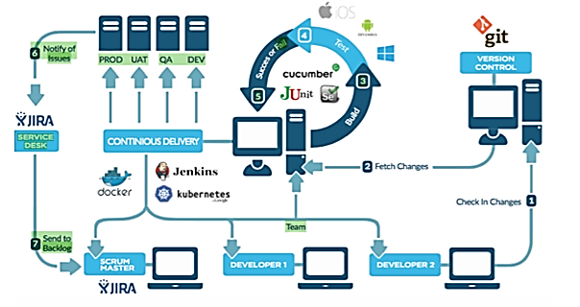
DevOps Workflow
Notes:
Deliverables:
Dates in each phase – Actual or Forecast
Color fill – Status/Risk with respect to forecast date
Thick Borders – In Progress items.
Build Status:
Planned – Original planned scope/dates/budget
Amended/Forecast
Actual – Current
Actual % - Actual / planned
Color fill -- Status/Risk with respect to Amended/Forecast
Milestones
Color fill – Status/Risk with respect to forecast date
Thick Borders – In Progress items.
Top Risks
Color fill in Due date - Status/Risk with respect to due date

Slide 4
Roadmap
PritiX |  | मई-17 |  |  |  |  |  |  |  |  |  | जून-17
 |  | Week 3 |  |  |  |  | Week 4 |  |  |  |  | Week 1 |  |  |  |  | Week 2
1 | Application workflow
2 | Design Application Architechure diagram
3 | Database Design
4 | Create database Project
5 | Create unit test for database
6 | Application Design
7 | Create web form application
8 | Unit test project for application
9 | Login module
10 | Dictionary module
11 | Assessment module
12 | Deployment Plan
13 | CI Build setup
14 | CD build setup
15 | Release setup
16 | Deployment pipelines QA, UAT, PROD
12 | Feedback/Support
13 | Monitoring application
14 | Implementation support system
 | Completed
 | Inprogress
 | Monitoring and improvement
 | Projected
Notes:
Deliverables:
Dates in each phase – Actual or Forecast
Color fill – Status/Risk with respect to forecast date
Thick Borders – In Progress items.
Build Status:
Planned – Original planned scope/dates/budget
Amended/Forecast
Actual – Current
Actual % - Actual / planned
Color fill -- Status/Risk with respect to Amended/Forecast
Milestones
Color fill – Status/Risk with respect to forecast date
Thick Borders – In Progress items.
Top Risks
Color fill in Due date - Status/Risk with respect to due date

Slide 5
Thank you!
Notes:
Deliverables:
Dates in each phase – Actual or Forecast
Color fill – Status/Risk with respect to forecast date
Thick Borders – In Progress items.
Build Status:
Planned – Original planned scope/dates/budget
Amended/Forecast
Actual – Current
Actual % - Actual / planned
Color fill -- Status/Risk with respect to Amended/Forecast
Milestones
Color fill – Status/Risk with respect to forecast date
Thick Borders – In Progress items.
Top Risks
Color fill in Due date - Status/Risk with respect to due date

